Slide 1
5. Arrays
1.1–1.2
Notes:
(5.1a) Declare, create, and initialize one-dimensional(1D) and two-dimensional (2D) arrays.
(5.1b) Explain Java’s default array initialization.
(5.1c) Describe and implement initializer lists to initialize arrays.
(5.1d) Describe and illustrate memory representation and allocation involving array implementations in Java.
(5.1e) Distinguish between valid and invalid array index references in code segments.
(5.1f) Identify ArrayIndexOutOfBoundsExceptionsin program code segments.
(5.1g) Implement Java code to manipulate 1D arrays including, but not limited to, the following tasks:
Traverse and display the elements in an array in order and in reverse order.
Reverse the elements in an array.
Find and report the minimum/maximum value in an array.
Find and report the index of the minimum/maximum value in an array.
Find the average of numerical values in an array.
Exchange values of two elements in an array.
Shift elements in array to the right/left as specifications describe.
Count the number of elements in an array satisfying given specifications.
Remove elements that satisfy certain conditions from an array.
Remove duplicate values from an array.
(5.1h) Demonstrate the use of the enhanced for loop (for-each) when writing code involving arrays.
(5.1i) Distinguish between situations that can and that cannot utilize an enhanced for loop.
(5.1j) Determinethe result of program code that traverses and manipulates the elements in a 2D array.
(5.1k) Trace and implement code to traverse and manipulate 2D arrays in row-major and column-major order.

Slide 2
5. Arrays
Array data structure
Declare, create and initialize
Memory representation and allocation
Array bounds
Examples of array-processing code
Example: Playing Cards
Two-dimensional arrays
adopted and modified from Slides by Sedgewick and Wayne

Slide 3
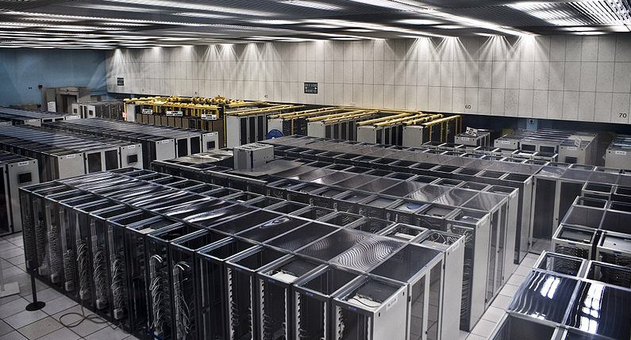
Basic Building Blocks of Programming
any program you might want to write
objects
functions and modules
graphics, sound, and image I/O
arrays
Ability to store and process huge amounts of data
conditionals and loops
Math
text I/O
primitive data types
assignment statements
Notes:
(5.1a) Declare, create, and initialize one-dimensional(1D) and two-dimensional (2D) arrays.

Slide 4
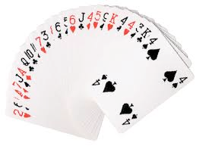
Data Structures
A data structure is an arrangement of data that enables efficient processing by a program.
An array is an indexed sequence of values of the same type.
Examples.
52 playing cards in a deck.
100 thousand students in an online class.
1 billion pixels in a digital image.
4 billion nucleotides in a DNA strand.
73 billion Google queries per year.
86 billion neurons in the brain.
50 trillion cells in the human body.
6.02 × 10²³ particles in a mole.
index | value
0 | 2♥
1 | 6♠
2 | A♦
3 | A♥
...
49 | 3♣
50 | K♣
51 | 4♠
Main purpose. Facilitate storage and manipulation of data.

Slide 5
5. Arrays
Array data structure
Declare, create and initialize
Memory representation and allocation
Array bounds
Typical array-processing code
Two-dimensional arrays

Slide 6
Declare, create and initialize
LO 5.1a
10 values, without arrays
double a0 = 0.0;
double a1 = 0.0;
double a2 = 0.0;
double a3 = 0.0;
double a4 = 0.0;
double a5 = 0.0;
double a6 = 0.0;
double a7 = 0.0;
double a8 = 0.0;
double a9 = 0.0;
...
a4 = 3.0;
...
a8 = 8.0;
...
double x = a4 + a8;
10 values, with an array
1 million values, with an array
double[] a;
a = new double[10];
...
a[4] = 3.0;
...
a[8] = 8.0;
...
double x = a[4] + a[8];
double[] a;
a = new double[1000000];
...
a[234567] = 3.0;
...
a[876543] = 8.0;
...
double x = a[234567] + a[876543];
an easy alternative
scales to handle huge amounts of data
tedious and error-prone code
Notes:
(5.1a) Declare, create, and initialize one-dimensional(1D) and two-dimensional (2D) arrays.

Slide 7
create and initialize
LO 5.1bc
100 values, without explicit initialization
int[] a;
a = new int[100];
5 values, initialize with a list
Using Arrays.fill()
double[] a = {1, 2.0, 3, 4, 5} ;
int a[] = new int[100];
Arrays.fill(a, 20);
In Java, all array elements are
Initialized to 0
However, this might not be true
for other languages.
Initialize an array with a list
fill the array with the value 20
Notes:
(5.1b) Explain Java’s default array initialization.
(5.1c) Describe and implement initializer lists to initialize arrays.

Slide 8
5. Arrays
The first data structure
Declare, create and initialize
Memory representation and allocation
Array bounds
Typical array-processing code
Example: Playing Cards
Two-dimensional arrays

Slide 9
Memory representation of an array
LO 5.1d
An array is an indexed sequence of values of the same type.
A computer's memory is also an indexed sequence of memory locations.
Each primitive type value occupies a fixed number of locations.
Array values are stored in contiguous locations.
stay tuned for many details
a
for simplicity in this lecture, think of a as the memory address of the first location
the actual implementation in Java is just slightly more complicated.
a[0] | a[1] | a[2] | a[3] | a[4] | a[5] | a[6] | a[7] | a[8] | a[9]
Critical concepts
Indices start at 0.
Given i, the operation of accessing the value a[i] is extremely efficient.
The assignment b = a makes the names b and a refer to the same array.
it does not copy the array, as with primitive types
(stay tuned for details)
Notes:
(5.1d) Describe and illustrate memory representation and allocation involving array implementations in Java.

Slide 10
Java language support for arrays
LO 5.1bc
Basic support
operation | typical code
Declare an array | double[] a;
Create an array of a given length | a = new double[1000];
Refer to an array entry by index | a[i] = b[j] + c[k];
Refer to the length of an array | a.length;
Initialization options
no need to use a loop like
for (int i = 0; i < 1000; i++)
a[i] = 0.0;
operation | typical code
Default initialization to 0 for numeric types | a = new double[1000];
Declare, create and initialize in one statement | double[] a = new double[1000];
Initialize to literal values | double[] x = { 0.3, 0.6, 0.1 };
BUT cost of creating an array is proportional to its length.

Slide 11
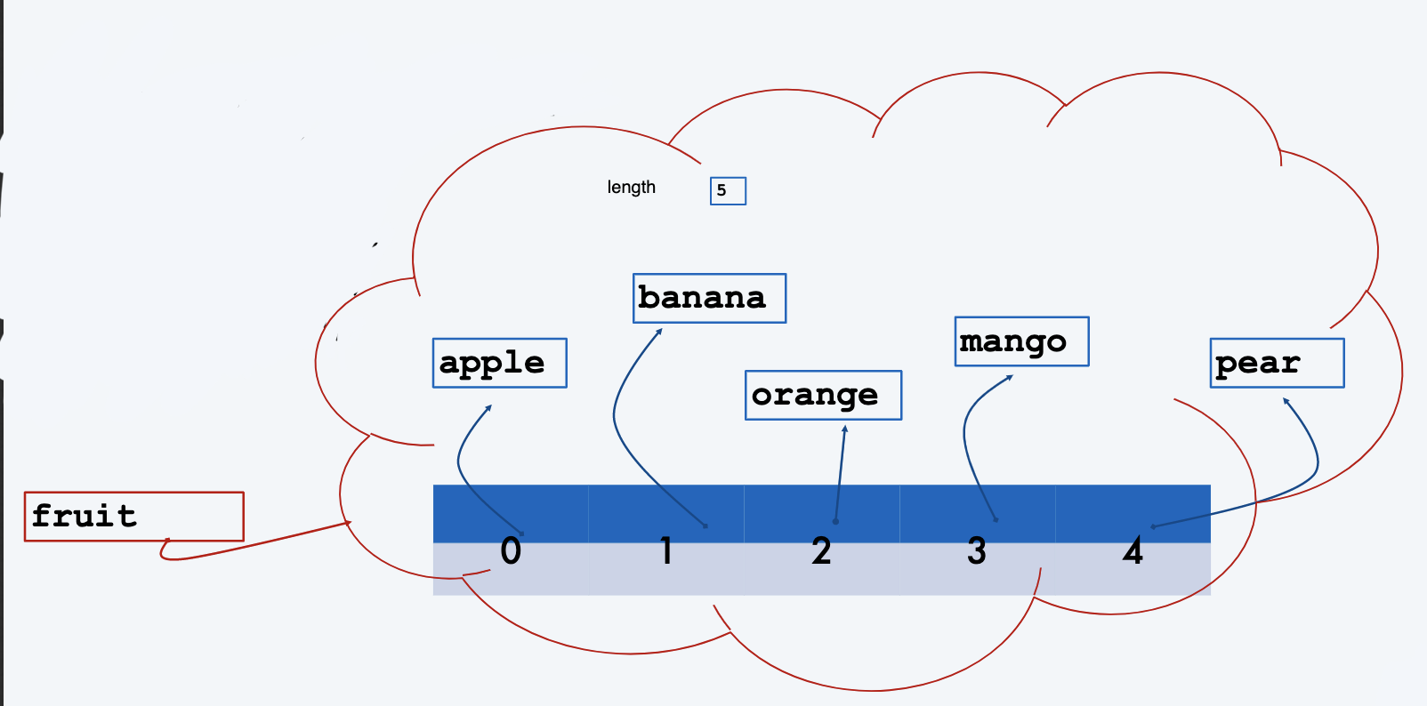
Example: Array of Strings
String[] fruit= newString[5];
fruit[0] = "apple";
fruit[1] = "banana";
fruit[2] = "orange";
fruit[3] = "mango";
fruit[4] = "pear";

Slide 12
Some Array "tasks” (ArrayTasks.java)
Traverse an array
Find the largest (or smallest) value in an array
Find the average value in an array
Find the average of the values in an array excluding the largest value and the smallest value in the array
Count the number of elements above (or below) the average
Search for a value in the array: return the index of the first occurrence of the value or -1 if the value is not in the array.
Reverse the values in an array.
Copy an array
Shift elements in array to the right/left as specifications describe.

Slide 13
Copying an array
LO 5.1g
To copy an array, create a new array , then copy all the values.
double[] b = new double[a.length];
for (int i = 0; i < a.length; i++)
b[i] = a[i];
a
i
b
i
0.3 | 0.6 | 0.99 | 0.01 | 0.5
0.3 | 0.6 | 0.99 | 0.01 | 0.5
Important note: The code b = a does not copy an array (it makes b and a refer to the same array).
double[] b = new double[a.length];
b = a;
a
b
0.3 | 0.6 | 0.99 | 0.01 | 0.5
Notes:
(5.1g) Implement Java code to manipulate 1D arrays including, but not limited to, the following tasks:
Traverse and display the elements in an array in order and in reverse order.
Reverse the elements in an array.
Find and report the minimum/maximum value in an array.
Find and report the index of the minimum/maximum value in an array.
Find the average of numerical values in an array.
Exchange values of two elements in an array.
Shift elements in array to the right/left as specifications describe.
Count the number of elements in an array satisfying given specifications.
Remove elements that satisfy certain conditions from an array.
Remove duplicate values from an array.

Slide 14
Programming with arrays: typical examples
Access command-line args in system array
Copy to another array
int stake = Integer.parseInt(args[0]);
int goal = Integer.parseInt(args[1]);
int trials = Integer.parseInt(args[2]);
double[] b = new double[N];
for (int i = 0; i < N; i++)
b[i] = a[i];
Create an array with N random values
Print array values, one per line
double[] a = new double[N];
for (int i = 0; i < N; i++)
a[i] = Math.random();
for (int i = 0; i < N; i++)
System.out.println(a[i]);
Compute the average of array values
Find the maximum of array values
double sum = 0.0;
for (int i = 0; i < N; i++)
sum += a[i];
double average = sum / N;
double max = a[0];
for (int i = 1; i < N; i++)
if (a[i] > max) max = a[i];
For brevity, N is a.length and b.length in all this code.

Slide 15
Pop quiz 1 on arrays – VERY IMPORTANT!
LO 5.1bc
Q. What does the following code print?
public class PQarray1
{
public static void main(String[] args)
{
int[] a = new int[6];
int[] b = new int[a.length];
b = a;
for (int i = 1; i < b.length; i++)
b[i] = i;
for (int i = 0; i < a.length; i++)
System.out.print(a[i] + " ");
System.out.println();
for (int i = 0; i < b.length; i++)
System.out.print(b[i] + " ");
System.out.println();
}
}

Slide 16
Pop quiz 1 on arrays
LO 5.1d
Q. What does the following code print?
public class PQarray1
{
public static void main(String[] args)
{
int[] a = new int[6];
int[] b = new int[a.length];
b = a;
for (int i = 1; i < b.length; i++)
b[i] = i;
for (int i = 0; i < a.length; i++)
System.out.print(a[i] + " ");
System.out.println();
for (int i = 0; i < b.length; i++)
System.out.print(b[i] + " ");
System.out.println();
}
}
After this, b and a refer to the same array
A.
% java PQ4_1
0 1 2 3 4 5
0 1 2 3 4 5
Notes:
(5.1d) Describe and illustrate memory representation and allocation involving array implementations in Java.

Slide 17

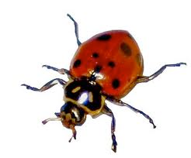

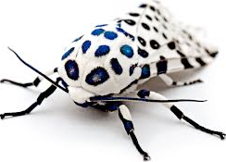
Programming with arrays: typical bugs
LO 5.1f
Array index out of bounds
double[] a = new double[10];
for (int i = 1; i <= 10; i++)
a[i] = Math.random();
No a[10] (and a[0] unused)
Uninitialized array
double[] a;
for (int i = 0; i < 9; i++)
a[i] = Math.random();
Never created the array
Undeclared variable
a = new double[10];
for (int i = 0; i < 10; i++)
a[i] = Math.random();
What type of data does a refer to?

Slide 18
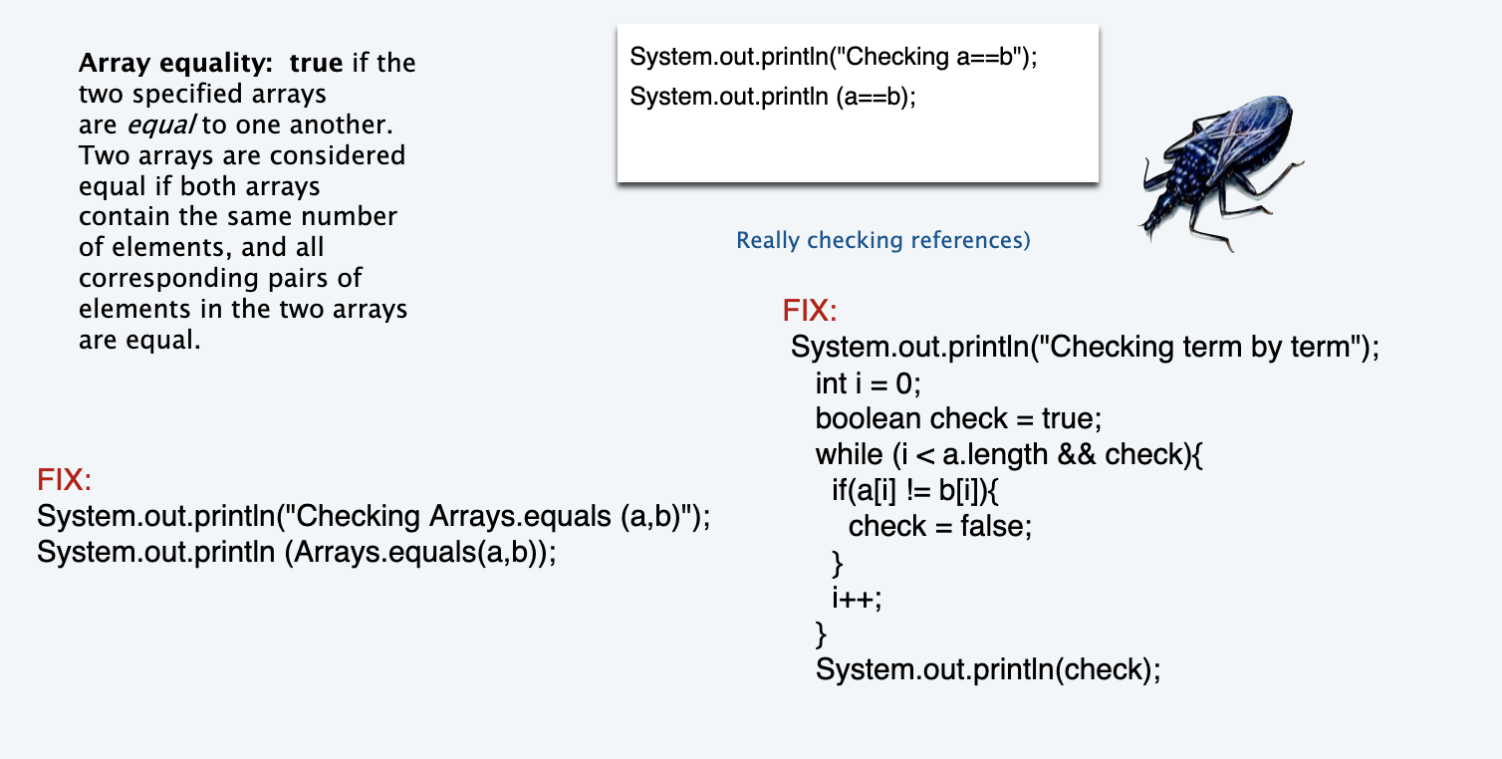
Programming with arrays: typical bugs

Slide 19
5. Arrays
The first data structure
Declare, create and initialize
Memory representation and allocation
Array bounds
Typical array-processing code
Example: Playing Cards
Two-dimensional arrays

Slide 20
Array bounds
LO 5.1ef
Bounds. An array of size n contains n cells to store data
Example
int[] a = new int[10];
a[0] = 10
a[9] = 20
a[-1] = 10
a[10] = 10
declaration
legal
legal
Illegal. ArrayIndexOutOfBoundsException
Illegal. Illegal. ArrayIndexOutOfBoundsException
Array index out of bounds exception. Is thrown when accessing a cell illegally

Slide 21
5. Arrays
The first data structure
Declare, create and initialize
Memory representation and allocation
Array bounds
Examples of array-processing code
Example: Playing Cards
Two-dimensional arrays

Slide 22
Examples. Manipulating 1D arrays
LO 5.1g
Q. How do we traverse and display elements in an array, in order and reverse order?
Q. How do we reverse the elements in an integer array?
A.
// in order
for (int i = 0; i < a.length; i++)
System.out.println(a[i]);
// reverse order
for (int i = a.length-1; i >= 0; i--)
System.out.println(a[i]);
A.
// reverse array
for (int i = 0; i < a.length/2; i++) {
int temp = a[i];
a[i] = a[a.length-i-1];
a[a.length-i-1] = temp
}
Notes:
LO:
Traverse and display the elements in an array in order and in reverse order.
Reverse the elements in an array.

Slide 23
Examples. Manipulating 1D arrays
LO 5.1g
Q. How do we find and report min and max elements in an integer array?
Q. How do we find and report index of the min and max elements in an integer array?
A.
int max = Integer.MIN_VALUE;
int min = Integer.MAX_VALUE;
for (int i = 0; i < a.length; i++) {
if (a[i] > max)
max = a[i];
if (a[i] < min)
min = a[i];
}
System.out.println(min);
System.out.println(max);
A.
int max = Integer.MIN_VALUE;
int min = Integer.MAX_VALUE;
Int maxIndex = 0, minIndex=0;
for (int i = 0; i < a.length; i++) {
if (a[i] > max)
{max = a[i]; maxIndex = i;}
if (a[i] < min)
{ min = a[i]; minIndex = i;}
}
System.out.println(min);
System.out.println(max);
Notes:
LO:
Find and report the minimum/maximum value in an array.
Find and report the index of the minimum/maximum value in an array.

Slide 24
Examples. Manipulating 1D arrays
LO 5.1g
Q. How do find the average of numerical values in an integer array?
Q. How do we exchange values of two elements in an integer array?
A.
// exchange two values at indices i and j
if (i < 0 || i >= a.length) {
System.out.println(“Array index out of bounds”);
return;
}
if (j < 0 || j >= a.length) {
System.out.println(“Array index out of bounds”);
return;
}
Int temp = a[i];
a[i] = a[j];
a[j] = tmp;
A.
double sum = 0;
for (int i = 0; i < a.length; i++) {
sum += a[i]
}
System.out.println(sum/a.length);
Q. Why is sum declared to be double?
A. Otherwise sum/a.length is performed as an integer division?
Notes:
LO:
Find the average of numerical values in an array.
Exchange values of two elements in an array.

Slide 25
Examples. Manipulating 1D arrays
LO 5.1g
Q. How to shift elements in an array to right?
Q. How to shift elements in an array to left?
A.
for (int i = a.length-1; i>=1; i--) {
a[i] = a[i-1];
}
Q. What is the value of a[1] after the shift?
A. It is the same as a[0]
A.
for (int i = 0; i < a.length-1; i++) {
a[i] = a[i+1];
}
Q. Which element of the original array is lost after the shift?
A. a[0] is lost
Notes:
LO:
Shift elements in array to the right/left as specifications describe.
Count the number of elements in an array satisfying given specifications.

Slide 26
Examples. Manipulating 1D arrays
LO 5.1g
Q. How do remove negative integers from an array and replace them with 0?
Q. How do remove duplicate values from an array and replace them with 0’s?
A.
for (int i = 0; i < a.length; i++) {
if (a[i] < 0)
a[i] = 0;
}
A.
Arrays.sort(a);
for (int i=0; i < a.length ; i++) {
int j = i+1;
while (j < a.length && a[j] == a[i])
{ a[j] = 0; j++;}
if (j == a.length) break;
i = j;
}
}
Notes:
LO:
Remove elements that satisfy certain conditions from an array.
Remove duplicate values from an array.

Slide 27
5. Arrays
The first data structure
Declare, create and initialize
Memory representation and allocation
Array bounds
Examples of array-processing code
Example: Playing Cards
Two-dimensional arrays

Slide 28
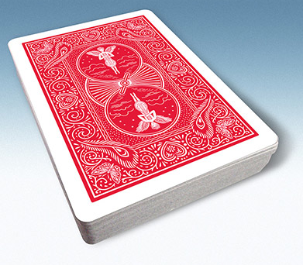
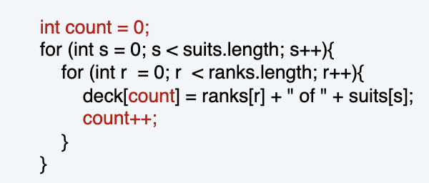
Example of array use: create a deck of cards
Define three arrays
Ranks.
Suits.
Full deck.
String[] rank = {"2", "3", "4", "5", "6", "7", "8", "9", "10", "J", "Q", "K", "A" };
String[] suit = { "♣", "♦", "♥", "♠" };
Use nested for loops to put all the cards in the deck.
for (int j = 0; j < 4; j++)
for (int i = 0; i < 13; i++)
deck[i + 13*j] = rank[i] + suit[j];
better style to use rank.length and suit.length
clearer in lecture to use 4 and 13
0 | 1 | 2 | 3
♣ | ♦ | ♥ | ♠
suit
0 | 1 | 2 | 3 | 4 | 5 | 6 | 7 | 8 | 9 | 10 | 11 | 12
2 | 3 | 4 | 5 | 6 | 7 | 8 | 9 | 10 | J | Q | K | A
Alternate solution:
rank
0 | 1 | 2 | 3 | 4 | 5 | 6 | 7 | 8 | 9 | 10 | 11 | 12 | 13 | 14 | 15 | 16 | 17 | 18 | 19 | 20 | ...
2♣ | 3♣ | 4♣ | 5♣ | 6♣ | 7♣ | 8♣ | 9♣ | 10♣ | J♣ | Q♣ | K♣ | A♣ | 2♦ | 3♦ | 4♦ | 5♦ | 6♦ | 7♦ | 8♦ | 9♦ | ...

Slide 29
Example of array use: create a deck of cards
public class Deck
{
public static void main(String[] args)
{
String[] rank = {"2", "3", "4", "5", "6", "7", "8", "9", "10", "J", "Q", "K", "A" };
String[] suit = { "♣", "♦", "♥", "♠" };
String[] deck = new String[52];
for (int j = 0; j < 4; j++)
for (int i = 0; i < 13; i++)
deck[i + 13*j] = rank[i] + suit[j];
for (int i = 0; i < 52; i++)
System.out.print(deck[i] + " ");
System.out.println();
}
}
% java Deck
2♣ 3♣ 4♣ 5♣ 6♣ 7♣ 8♣ 9♣ 10♣ J♣ Q♣ K♣ A♣ 2♦ 3♦ 4♦ 5♦ 6♦ 7♦ 8♦ 9♦ 10♦ J♦ Q♦ K♦ A♦ 2♥ 3♥ 4♥ 5♥ 6♥ 7♥ 8♥ 9♥ 10♥ J♥ Q♥ K♥ A♥ 2♠ 3♠ 4♠ 5♠ 6♠ 7♠ 8♠ 9♠ 10♠ J♠ Q♠ K♠ A♠
%

Slide 30
Pop quiz 2 on arrays
Q. What happens if the order of the for loops in Deck is switched?
for (int j = 0; j < 4; j++)
for (int i = 0; i < 13; i++)
deck[i + 13*j] = rank[i] + suit[j];
for (int i = 0; i < 13; i++)
for (int j = 0; j < 4; j++)
deck[i + 13*j] = rank[i] + suit[j];

Slide 31
Pop quiz 2 on arrays
LO 5.1k
Q. What happens if the order of the for loops in Deck is switched?
for (int j = 0; j < 4; j++)
for (int i = 0; i < 13; i++)
deck[i + 13*j] = rank[i] + suit[j];
for (int i = 0; i < 13; i++)
for (int j = 0; j < 4; j++)
deck[i + 13*j] = rank[i] + suit[j];
A. The array is filled in a different order, but the output is the same.
j
0 | 1 | 2 | 3
♣ | ♦ | ♥ | ♠
suit
i
0 | 1 | 2 | 3 | 4 | 5 | 6 | 7 | 8 | 9 | 10 | 11 | 12
2 | 3 | 4 | 5 | 6 | 7 | 8 | 9 | 10 | J | Q | K | A
rank
0 | 1 | 2 | ... | 12 | 13 | 14 | 15 | ... | 25 | 26 | 27 | 28 | ... | 38 | 39 | 40 | 41 | ... | 51
deck
2♣
3♣
4♣
...
A♣
2♦
3♦
4♦
...
A♦
2♥
3♥
4♥
...
A♥
2♠
3♠
4♠
...
A♠
NOTE: Error on page 92 in 3rd printing of text (see errata list on booksite).
Notes:
(5.1k) Trace and implement code to traverse and manipulate 2D arrays in row-major and column-major order.

Slide 32
Pop quiz 3 on arrays
Q. Change Deck to put the cards in rank order in the array.
% java Deck
2♣ 2♦ 2♥ 2♠ 3♣ 3♦ 3♥ 3♠ 4♣ 4♦ 4♥ 4♠ 5♣ 5♦ 5♥ 5♠ 6♣ 6♦ 6♥ 6♠ 7♣ 7♦ 7♥ 7♠ 8♣ 8♦ 8♥ 8♠ 9♣ 9♦ 9♥ 9♠ 10♣ 10♦ 10♥ 10♠ J♣ J♦ J♥ J♠ Q♣ Q♦ Q♥ Q♠ K♣ K♦ K♥ K♠ A♣ A♦ A♥ A♠
%

Slide 33
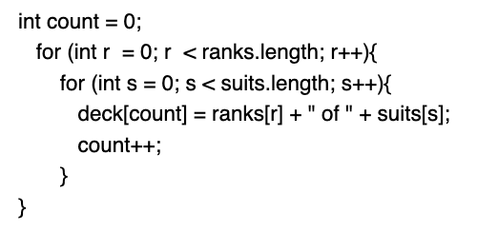
Pop quiz 3 on arrays
Q. Change Deck to put the cards in rank order in the array.
% java Deck
2♣ 2♦ 2♥ 2♠ 3♣ 3♦ 3♥ 3♠ 4♣ 4♦ 4♥ 4♠ 5♣ 5♦ 5♥ 5♠ 6♣ 6♦ 6♥ 6♠ 7♣ 7♦ 7♥ 7♠ 8♣ 8♦ 8♥ 8♠ 9♣ 9♦ 9♥ 9♠ 10♣ 10♦ 10♥ 10♠ J♣ J♦ J♥ J♠ Q♣ Q♦ Q♥ Q♠ K♣ K♦ K♥ K♠ A♣ A♦ A♥ A♠
%
A.
for (int i = 0; i < 13; i++)
for (int j = 0; j < 4; j++)
deck[4*i + j] = rank[i] + suit[j];
j
0 | 1 | 2 | 3
♣ | ♦ | ♥ | ♠
suit
Alternate solution:
i
0 | 1 | 2 | 3 | 4 | 5 | 6 | 7 | 8 | 9 | 10 | 11 | 12
2 | 3 | 4 | 5 | 6 | 7 | 8 | 9 | 10 | J | Q | K | A
rank
0 | 1 | 2 | 3 | 4 | 5 | 6 | 7 | 8 | 9 | 10 | 11 | 12 | ...
2♣ | 2♦ | 2♥ | 2♠ | 3♣ | 3♦ | 3♥ | 3♠ | 4♣ | 4♦ | 4♥ | 4♠ | 5♣ | ...
deck

Slide 34

Array application: take a card, any card
Problem: Print a random sequence of N cards.
Algorithm
Take N from the command line and do the following N times
Calculate a random index r between 0 and 51.
Print deck[r].
Implementation: Add this code instead of printing deck in Deck.
for (int i = 0; i < N; i++)
{
int r = (int) (Math.random() * 52);
System.out.println(deck[r]);
}
each value between 0 and 51 equally likely
Note: Same method is effective for printing a random sequence from any data collection.
Notes:
LO:
Remove elements that satisfy certain conditions from an array.
Remove duplicate values from an array.

Slide 35
Array application: random sequence of cards
public class DrawCards
{
public static void main(String[] args)
{
int N = Integer.parseInt(args[0]);
String[] rank = {"2", "3", "4", "5", "6", "7", "8", "9","10", "J", "Q", "K", "A" };
String[] suit = { "♣", "♦", "♥", "♠" };
String[] deck = new String[52];
for (int i = 0; i < 13; i++)
for (int j = 0; j < 4; j++)
deck[i + 13*j] = rank[i] + suit[j];
for (int i = 0; i < N; i++)
{
int r = (int) (Math.random() * 52);
System.out.print(deck[r] + " ");
}
System.out.println();
}
}
% java DrawCards 10
6♥ K♦ 10♠ 8♦ 9♦ 9♥ 6♦ 10♠ 3♣ 5♦
% java DrawCards 10
2♦ A♠ 5♣ A♣ 10♣ Q♦ K♣ K♠ A♣ A♦
% java DrawCards 10
6♠ 10♦ 4♥ A♣ K♥ Q♠ K♠ 7♣ 5♦ Q♠
% java DrawCards 10
A♣ J♣ 5♥ K♥ Q♣ 5♥ 9♦ 9♣ 6♠ K♥
Note: Sample is with replacement (same card can appear multiple times).
appears twice

Slide 36

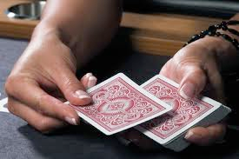
Array application: shuffle and deal from a deck of cards
Problem: Print N random cards from a deck.
Algorithm: Shuffle the deck, then deal.
Consider each card index i from 0 to 51.
Calculate a random index r between i and 51.
Exchange deck[i] with deck[r]
Print the first N cards in the deck.
for (int i = 0; i < 52; i++)
{
int r = i + (int) (Math.random() * (52-i));
String t = deck[r];
deck[r] = deck[i];
deck[i] = t;
}
for (int i = 0; i < N; i++)
System.out.print(deck[i]);
System.out.println();
Implementation
each value
between i and 51
equally likely

Slide 37
Array application: shuffle a deck of 10 cards (trace)
for (int i = 0; i < 10; i++)
{
int r = i + (int) (Math.random() * (10-i));
String t = deck[r];
deck[r] = deck[i];
deck[i] = t;
}
i | r | deck
 |  | 0 | 1 | 2 | 3 | 4 | 5 | 6 | 7 | 8 | 9
 |  | 2♣ | 3♣ | 4♣ | 5♣ | 6♣ | 7♣ | 8♣ | 9♣ | 10♣ | J♣
0 | 7 | 9♣ | 3♣ | 4♣ | 5♣ | 6♣ | 7♣ | 8♣ | 2♣ | 10♣ | J♣
1 | 3 | 9♣ | 5♣ | 4♣ | 3♣ | 6♣ | 7♣ | 8♣ | 2♣ | 10♣ | J♣
2 | 9 | 9♣ | 5♣ | J♣ | 3♣ | 6♣ | 7♣ | 8♣ | 2♣ | 10♣ | 4♣
3 | 9 | 9♣ | 5♣ | J♣ | 4♣ | 6♣ | 7♣ | 8♣ | 2♣ | 10♣ | 3♣
4 | 6 | 9♣ | 5♣ | J♣ | 4♣ | 8♣ | 7♣ | 6♣ | 2♣ | 10♣ | 3♣
5 | 9 | 9♣ | 5♣ | J♣ | 4♣ | 8♣ | 3♣ | 6♣ | 2♣ | 10♣ | 7♣
6 | 8 | 9♣ | 5♣ | J♣ | 4♣ | 8♣ | 3♣ | 10♣ | 2♣ | 6♣ | 7♣
7 | 9 | 9♣ | 5♣ | J♣ | 4♣ | 8♣ | 3♣ | 10♣ | 7♣ | 6♣ | 2♣
8 | 8 | 9♣ | 5♣ | J♣ | 4♣ | 8♣ | 3♣ | 10♣ | 7♣ | 6♣ | 2♣
9 | 9 | 9♣ | 5♣ | J♣ | 4♣ | 8♣ | 3♣ | 10♣ | 7♣ | 6♣ | 2♣
Q. Why does this method work?
Uses only exchanges, so the deck after the shuffle has the same cards as before.
N−i equally likely values for deck[i].
Therefore N×(N−1)×(N−1)... ×2×1 = N! equally likely values for deck[].
Initial order is immaterial.
Note: Same method is effective for randomly rearranging any type of data.

Slide 38
shuffle and deal from a deck of cards
public class DealCards
{
public static void main(String[] args)
{
int N = Integer.parseInt(args[0]);
String[] rank = {"2", "3", "4", "5", "6", "7", "8", "9", "10", "J", "Q", "K", "A" };
String[] suit = { "♣", "♦", "♥", "♠" };
String[] deck = new String[52];
for (int i = 0; i < 13; i++)
for (int j = 0; j < 4; j++)
deck[i + 13*j] = rank[i] + suit[j];
for (int i = 0; i < 52; i++)
{
int r = i + (int) (Math.random() * (52-i));
String t = deck[r];
deck[r] = deck[i];
deck[i] = t;
}
for (int i = 0; i < N; i++)
System.out.print(deck[i]);
System.out.println();
}
}
random poker hand
% java DealCards 5
9♣ Q♥ 6♥ 4♦ 2♠
random bridge hand
% java DealCards 13
3♠ 4♥ 10♦ 6♥ 6♦ 2♠ 9♣ 8♠ A♠ 3♥ 9♠ 5♠ Q♥

Slide 39
Coupon collector
Coupon collector problem
M different types of coupons.
Collector acquires random coupons, one at a time, each type equally likely.
Q. What is the expected number of coupons needed to acquire a full collection?
Example: Collect all ranks in a random sequence of cards (M = 13).
Sequence
9♣ | 5♠ | 8♥ | 10♦ | 2♠ | A♠ | 10♥ | Q♦ | 3♠ | 9♥ | 5♦ | 9♣ | 7♦ | 2♦ | 8♣ | 6♣ | Q♥ | K♣ | 10♥ | A♦ | 4♦ | J♥
Collection
2 | 3 | 4 | 5 | 6 | 7 | 8 | 9 | 10 | J | Q | K | A
2♠
3♠
4♦
5♠
6♣
7♦
8♥
9♣
10♦
J♥
Q♦
K♣
A♠
22 cards needed
to complete collection
2♦
5♦
8♣
9♥
10♥
Q♥
A♦
9♣
10♥

Slide 40
Array application: coupon collector
Coupon collector simulation
Generate random int values between 0 and M−1.
Count number used to generate each value at least once.
public class Coupon
{
public static void main(String[] args)
{
int M = Integer.parseInt(args[0]);
int cards = 0; // number of cards collected
int distinct = 0; // number of distinct cards
boolean[] found = new boolean[M];
while (distinct < M)
{
int r = (int) (Math.random() * M);
cards++;
if (!found[r])
{
distinct++;
found[r] = true;
}
}
System.out.println(cards);
}
}
% java Coupon 13
46
% java Coupon 13
22
% java Coupon 13
54
% java Coupon 13
27
Key to the implementation
Create a boolean array of length M.(Initially all false by default.)
When r generated, check the rth value in the array.
If true, ignore it (not new).
If false, count it as new distinct value (and set rth entry to true)

Slide 41
Array application: coupon collector (trace for M = 6)
r | found |  |  |  |  |  | distinct | cards
 | 0 | 1 | 2 | 3 | 4 | 5
 | F | F | F | F | F | F | 0 | 0
2 | F | F | T | F | F | F | 1 | 1
0 | T | F | T | F | F | F | 2 | 2
4 | T | F | T | F | T | F | 3 | 3
0 | T | F | T | F | T | F | 3 | 4
1 | T | T | T | F | T | F | 4 | 5
2 | T | T | T | F | T | F | 4 | 6
5 | T | T | T | F | T | T | 5 | 7
0 | T | T | T | F | T | T | 5 | 8
1 | T | T | T | F | T | T | 5 | 9
3 | T | T | T | T | T | T | 6 | 10
boolean[] found = new boolean[M];
while (distinct < M)
{
int r = (int) (Math.random() * M);
cards++;
if (!found[r])
{
distinct++;
found[r] = true;
}
}

Slide 42
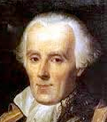
Simulation, randomness, and analysis (revisited)
Coupon collector problem
M different types of coupons.
Collector acquires random coupons, one at a time, each type equally likely.
Q. What is the expected number of coupons needed to acquire a full collection?
Pierre-Simon Laplace
1749-1827
A. (known via mathematical analysis for centuries) About M ln M + .57721M .
type | M | expected wait
playing card suits | 4 | 8
playing card ranks | 13 | 41
baseball cards | 1200 | 9201
Magic™ cards | 12534 | 125508
% java Coupon 4
11
% java Coupon 13
38
% java Coupon 1200
8789
% java Coupon 12534
125671
Remarks
Computer simulation can help validate mathematical analysis.
Computer simulation can also validate software behavior.
Example: Is Math.random() simulating randomness?

Slide 43
Simulation, randomness, and analysis (revisited)
Once simulation is debugged, experimental evidence is easy to obtain.
Analogous code for coupon collector, this lecture
public class CouponCollector
{
public static void main(String[] args)
{
int M = Integer.parseInt(args[0]);
int trials = Integer.parseInt(args[1]);
int cards = 0;
boolean[] found;
for (int i = 0; i < trials; i++)
{
int distinct = 0;
found = new boolean[M];
while (distinct < M)
{
int r = (int) (Math.random() * M);
cards++;
if (!found[r])
{
distinct++;
found[r] = true;
}
}
}
System.out.println(cards/trials);
}
}
Gambler's ruin simulation, previous lecture
public class Gambler
{
public static void main(String[] args)
{
int stake = Integer.parseInt(args[0]);
int goal = Integer.parseInt(args[1]);
int trials = Integer.parseInt(args[2]);
int wins = 0;
for (int i = 0; i < trials; i++)
{
int t = stake;
while (t > 0 && t < goal)
{
if (Math.random() < 0.5) t++;
else t--;
}
if (t == goal) wins++;
}
System.out.println(wins + " wins of " + trials);
}
}

Slide 44

Simulation, randomness, and analysis (revisited)
Coupon collector problem
M different types of coupons.
Collector acquires random coupons, one at a time, each type equally likely.
Q. What is the expected number of coupons needed to acquire a full collection?
Predicted by mathematical analysis
Observed by computer simulation
type | M | M ln M + .57721M
playing card suits | 4 | 8
playing card ranks | 13 | 41
playing cards | 52 | 236
baseball cards | 1200 | 9201
magic cards | 12534 | 125508
% java CouponCollector 4 1000000
8
% java CouponCollector 13 1000000
41
% java CouponCollector 52 100000
236
% java CouponCollector 1200 10000
9176
% java CouponCollector 12534 1000
125920
Hypothesis. Centuries-old analysis is correct
and Math.random() simulates randomness.

Slide 45
5. Arrays
The first data structure
Declare, create and initialize
Memory representation and allocation
Array bounds
Examples of array-processing code
Two-dimensional arrays

Slide 46

Two-dimensional arrays
A two-dimensional array is a doubly-indexed sequence of values of the same type.
Examples
Matrices in math calculations.
Grades for students in an online class.
Outcomes of scientific experiments.
Transactions for bank customers.
Pixels in a digital image.
Geographic data
...
grade
 | 0 | 1 | 2 | 3 | 4 | 5 | ...
0 | A | A | C | B | A | C
1 | B | B | B | B | A | A
2 | C | D | D | B | C | A
3 | A | A | A | A | A | A
4 | C | C | B | C | B | B
5 | A | A | A | B | A | A
...
student ID
y-coordinate
Main purpose. Facilitate storage and manipulation of data.
x-coordinate

Slide 47
Java language support for two-dimensional arrays (basic support)
LO 5.1j
operation | typical code
Declare a two-dimensional array | double[][] a;
Create a two-dimensional array of a given length | a = new double[1000][1000];
Refer to an array entry by index | a[i][j] = b[i][j] * c[j][k];
Refer to the number of rows | a.length;
Refer to the number of columns | a[i].length;
Refer to row i | a[i]
can be different
for each row
no way to refer to column j
a[][]
a[0][0] | a[0][1] | a[0][2] | a[0][3] | a[0][4] | a[0][5] | a[0][6] | a[0][7] | a[0][8] | a[0][9]
a[1][0] | a[1][1] | a[1][2] | a[1][3] | a[1][4] | a[1][5] | a[1][6] | a[1][7] | a[1][8] | a[1][9]
a[2][0] | a[2][1] | a[2][2] | a[2][3] | a[2][4] | a[2][5] | a[2][6] | a[2][7] | a[2][8] | a[2][9]
a[1]
a 3-by-10 array
Notes:
(5.1j) Determinethe result of program code that traverses and manipulates the elements in a 2D array.

Slide 48
Java language support for two-dimensional arrays (initialization)
LO 5.1j
no need to use nested loops like
for (int i = 0; i < 1000; i++)
for (int j = 0; j < 1000; j++)
a[i][j] = 0.0;
operation | typical code
Default initialization to 0 for numeric types | a = new double[1000][1000];
Declare, create and initialize in a single statement | double[][] a = new double[1000][1000];
Initialize to literal values | double[][] p = { { .92, .02, .02, .02, .02 }, { .02, .92, .32, .32, .32 }, { .02, .02, .02, .92, .02 }, { .92, .02, .02, .02, .02 }, { .47, .02, .47, .02, .02 }, };
BUT cost of creating an array is proportional to its size.

Slide 49
2D Arrays
public class twoDArrays {
public static void main (String[] args){
int[][] arr2d = { {1,2,3},{4,5,6},{7,8,9} };
for(int row = 0; row < arr2d.length; row++){
for (int col = 0; col < arr2d[row].length; col++){
System.out.print(arr2d[row][col] + " ");
}
System.out.println();
}
}
}
Three rows
Each row is an array
arr2d.length is the number of rows in arr2d
arr2d[row].length is the number of items (or columns) in that row....In the case of a rectangular array, we can use arr2d[0].length for the number of columns in the 2D array

Slide 50
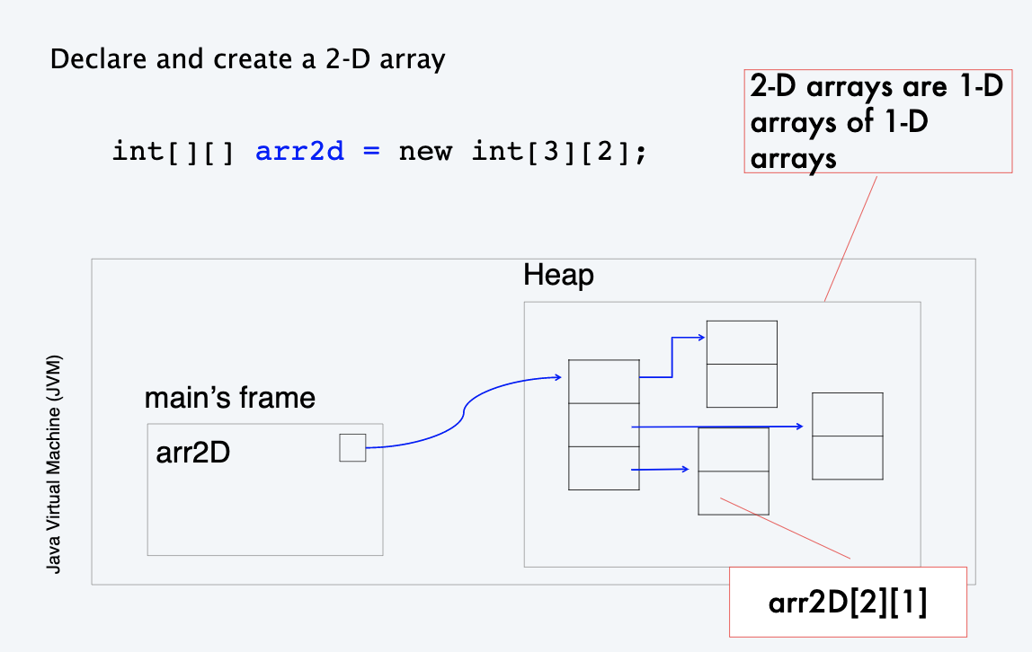
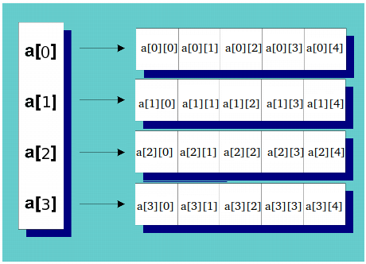
Creating a 2D Array in Java
Another way to look at it:

Slide 51
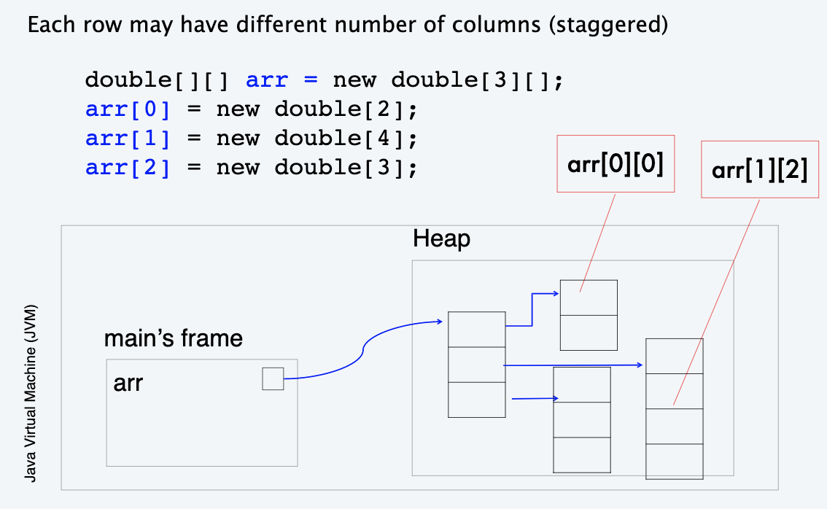
Creating a 2-D Array in Java

Slide 52
2D Array Length
double[][] arr = new double[3][];
arr[0] = new double[2];
arr[1] = new double[4];
arr[2] = new double[3];
arr.length → 3
Number of rows
Number of 1D arrays
arr[1].length → 4
Second row number of columns

Slide 53
Iterating over a 2-D Array
for(int row = 0; row < array.length; row++) {
for(int col = 0; col < array[row].length; col++) {
System.out.print(array[row][col]);
}
System.out.println();
}
Outer loop iterates over the rows
Inner loop iterates over the columns

Slide 54
2D Arrays – Example 1
Consider a class of 3 students, and each student takes 4 exams
Create a 1D array containing the average of each exam
In the example below, the array would be:
{67.000, 84.667, 86.00, 67.333}
avgE1 avgE2 avgE3 avgE4
 | Student 1 | Student 2 | Student 3
Exam 1 | 56 | 78 | 67
Exam 2 | 79 | 92 | 83
Exam 3 | 90 | 89 | 79
Exam 4 | 51 | 67 | 84

Slide 55
2D Arrays – Example 2
Consider a class of 3 students, and each student takes 4 exams
Create a 1D array containing the average of each student
In the example below, the array would be:
{69.000, 81.500, 78.250}
avgS1 avgS2 avgS3
 | Student 1 | Student 2 | Student 3
Exam 1 | 56 | 78 | 67
Exam 2 | 79 | 92 | 83
Exam 3 | 90 | 89 | 79
Exam 4 | 51 | 67 | 84

Slide 56
5. Arrays
Extra Practice Slides

Slide 57
Application of arrays: vector and matrix calculations
LO 5.1j
Mathematical abstraction: vector
Java implementation: 1D array
Mathematical abstraction: matrix
Java implementation: 2D array
Vector addition
Matrix addition
double[] c = new double[N];
for (int i = 0; i < N; i++)
c[i] = a[i] + b[i];
double[][] c = new double[N][N];
for (int i = 0; i < N; i++)
for (int j = 0; j < N; j++)
c[i][j] = a[i][j] + b[i][j];
.30 | .60 | .10
+
.50 | .10 | .40
=
.80 | .70 | .50
.70 | .20 | .10
.30 | .60 | .10
.50 | .10 | .40
.80 | .30 | .50
.10 | .40 | .10
.10 | .30 | .40
1.5 | .50 | .60
.40 | 1.0 | .20
.60 | .40 | .80
+
=

Slide 58
Application of arrays: vector and matrix calculations
Mathematical abstraction: vector
Java implementation: 1D array
Mathematical abstraction: matrix
Java implementation: 2D array
Vector dot product
Matrix multiplication
double sum = 0.0;
for (int i = 0; i < N; i++)
sum += a[i]*b[i];
double[][] c = new double[N][N];
for (int i = 0; i < N; i++)
for (int j = 0; j < N; j++)
for (int k = 0; k < N; k++)
c[i][j] += a[i][k] * b[k][j];
.30 | .60 | .10
∙
.50 | .10 | .40
=
.25
i | x[i] | y[i] | x[i]*y[i] | sum
0 | 0.3 | 0.5 | 0.15 | 0.15
1 | 0.6 | 0.1 | 0.06 | 0.21
2 | 0.1 | 0.4 | 0.04 | 0.25
.70 | .20 | .10
.30 | .60 | .10
.50 | .10 | .40
.80 | .30 | .50
.10 | .40 | .10
.10 | .30 | .40
.59 | .32 | .41
.31 | .36 | .25
.45 | .31 | .42
*
=
end-of-loop trace

Slide 59
Pop quiz 4 on arrays
LO 5.1j
Q. How many multiplications to multiply two N-by-N matrices?
double[][] c = new double[N][N];
for (int i = 0; i < N; i++)
for (int j = 0; j < N; j++)
for (int k = 0; k < N; k++)
c[i][j] += a[i][k] * b[k][j];
1. N
2. N²
3. N³
4. N⁴

Slide 60
Pop quiz 4 on arrays
Q. How many multiplications to multiply two N-by-N matrices?
double[][] c = new double[N][N];
for (int i = 0; i < N; i++)
for (int j = 0; j < N; j++)
for (int k = 0; k < N; k++)
c[i][j] += a[i][k] * b[k][j];
1. N
2. N²
3. N³
4. N⁴
Nested for loops: N × N × N

Slide 61
Image sources
http://commons.wikimedia.org/wiki/File:CERN_Server_03.jpg
Image sources
http://en.wikipedia.org/wiki/Airedale_Terrier#mediaviewer/File:Airedale_Terrier.jpg
http://www.nobelprize.org/nobel_prizes/chemistry/laureates/1974/flory_postcard.jpg
Image sources
http://www.vis.gr.jp/~nazoya/cgi-bin/catalog/img/CARDSBIC809_red.jpg
http://www.alegriphotos.com/Shuffling_cards_in_casino-photo-deae1081e5ebc6631d6871f8b320b808.html
http://iveypoker.com/wp-content/uploads/2013/09/Dealing.jpg
http://upload.wikimedia.org/wikipedia/commons/b/bf/Pierre-Simon,_marquis_de_Laplace_(1745-1827)_-_Guérin.jpg

Slide 62
5. Arrays
The first data structure
Declare, create and initialize
Memory representation and allocation
Array bounds
Examples of array-processing code
Two-dimensional arrays

Slide 63
5. Arrays
1.1–1.2

